Slide 1


Shubhanshu nishad young scientist of India & founder & CEO of meta educator
Contact me :
Phone no : 9455593295
Email id : metaeducator@gmail.com
Instagram : metaeducator

Slide 2
Web development bootcamp (2 week course )
HTML is used to create electronic documents (called pages) that are displayed on the World Wide Web.
CSS stands for Cascading Style Sheets. It is the language for describing the presentation of Web pages, including colors, layout, and fonts, thus making our web pages presentable to the users.
BOOTSTRAP
Bootstrap is a HTML, CSS & JS Library that focuses on simplifying the development of informative web pages (as opposed to web apps).
CSS
HTML

Slide 3


 | HTML - SKELETON OF WEBSITE
 |  |  |  | csS- bODY OF WEBSITE
csS- bODY OF WEBSITE

Slide 4

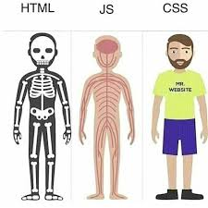
JAVASCRIPT - BRAIN OF WEBSITE
IN SINGLE PICTURES

Slide 5
HTML
HTML stands for Hyper Text Markup Language
HTML is the standard markup language for Web pages
HTML elements are the building blocks of HTML pages
HTML elements are represented by <> tag

Slide 6
CSS
CSS stands for Cascading Style Sheets
CSS describes how HTML elements are to be displayed on screen, paper, or in other media
CSS saves a lot of work. It can control the layout of multiple web pages all at once
External stylesheets are stored in CSS files

Slide 7
JAVASCRIPT
# JavaScript
is the Programming Language for the Web.
# JavaScript
can update and change both HTML and CSS.
# JavaScript
can calculate, manipulate and validate Data.

Slide 8
Before you begin creating your own website and launch it to the Internet, it’s important to know how websites work.
Here are some basic terms:
A website is simply a collection of web pages of codes – codes that describes the layout, format and content on a page.
The web server is a internet-connected computer that receives the request for a web page sent by your browser.

Slide 9
The browser connects your computer to the server through an IP address. The IP address is obtained by translating the domain name. (Don’t worry, this part is all done automatically by your browser so you don’t have to look up the IP addresses yourself.)
In other words, in order to display your website on the Internet, you will need:
A website
A domain name
A server

Slide 10
Learn HTML Using Notepad or TextEdit
Web pages can be created and modified by using professional HTML editors.
However, for learning HTML we recommend a simple text editor like Notepad (PC) or TextEdit (Mac).
We believe in that using a simple text editor is a good way to learn HTML.
Follow the steps below to create your first web page with Notepad or TextEdit.

Slide 11
Step 1: Open Notepad (PC)
Windows 8 or later:
Open the Start Screen (the window symbol at the bottom left on your screen). Type Notepad.
Windows 7 or earlier:
Open Start > Programs > Accessories > Notepad

Slide 12
Step 1: Open TextEdit (Mac)
Open Finder > Applications > TextEdit
Also change some preferences to get the application to save files correctly. In Preferences > Format > choose "Plain Text“
Then under "Open and Save", check the box that says "Display HTML files as HTML code instead of formatted text".
Then open a new document to place the code.

Slide 13
DOWNLOADING VISUAL CODE
STUDIO
Click here to download it. https://code.visualstudio.com/download
# I am a web developer
#khabrilal of crush

Slide 14
Let's Write our First website…
Write or copy the following HTML code into Notepad:
<!DOCTYPE html>
<html lang="en">
<head>
<meta charset="UTF-8">
<meta name="viewport" content="width=device-width, initial-scale=1.0">
<title>My First Website...</title>
</head>
<body>
I am Very happy, & very soon I will become an expert web designers.
</body>
</html>

Slide 15
Explain Keyword.
The <!DOCTYPE html> declaration defines that this document is an HTML5 document
The <head> element contains meta information about the HTML page
The <title> element specifies a title for the HTML page (which is shown in the browser's title bar or in the page's tab)
The <body> element defines the document's body, and is a container for all the visible contents,
The <html> element is the root element of an HTML page

Slide 16
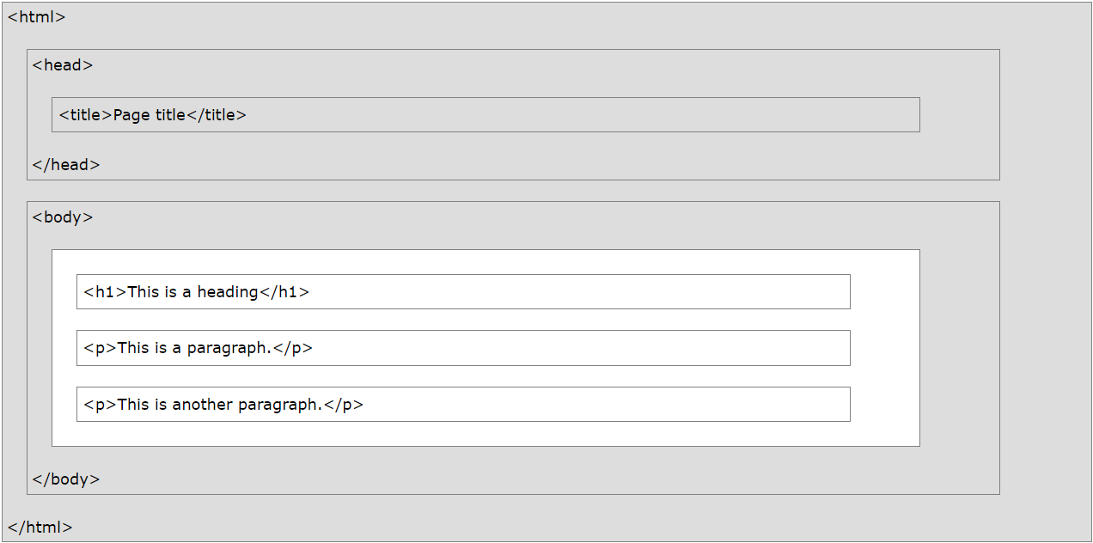
STRUCTURE….

Slide 17
cODE
<!DOCTYPE html> <html> <head> <title>Page Title</title> </head> <body> <h1>My First Heading</h1> <p>My first paragraph.</p> </body> </html>

Slide 18


